Slide 1


DATA SCIENCE CAPSTONE PROJECT
Valentine Zuh Njung
February 18, 2022

Slide 2

Outline
Executive Summary
Introduction
Methodology
Results
Conclusion
Appendix

Slide 3
Executive Summary
Summary of methodologies
Data collection
Data wrangling
EDA with data visualization
EDA with SQL
Building an interactive map with Folium
Building a Dashboard with Plotly Dash
Predictive analysis (Classification)
Summary of all results
Exploratory data analysis results
Interactive analytics demo in screenshots
Predictive analysis results

Slide 4
Introduction
Project background and context
Space X advertises Falcon 9 rocket launches on its website with a cost of 62 million dollars; The insurance rate on a Falcon 9 is about 4% currently, That’s the same rate as competitors’ similarly-capable rockets, such as the European launcher Arianespace’s Ariane 5 or U.S. rocket builder United Launch Alliance’s (ULA) Atlas V. But Ariane 5 and Atlas V launches go for upwards of $165 million each, meaning a Falcon 9 premium is about $2.5 million while its competitors’ premiums would be in the range of $7 million.much of the savings is because Space X can reuse the first stage. Therefore, if we can determine if the first stage will land, we can determine the cost of a launch. This information can be used if an alternate company wants to bid against space X for a rocket launch.

Slide 5
This goal of the project is to create a machine learning pipeline to predict if the first stage will land successfully.
Problems you want to find answers
What factors determine if the rocket will land successfully?
The interaction amongst various features that determine the success rate of a successful landing.
What operating conditions needs to be in place to ensure a successful landing program

Slide 6

Section 1

Slide 7
Methodology
Executive Summary
Data collection methodology:
Data was collected using SpaceX API and web scraping from Wikipedia.
Perform data wrangling
One-hot encoding was applied to categorical features. One hot encoding is a process by which categorical variables are converted into a form that could be provided to ML algorithms to do a better job in prediction. For the K-means Clustering Algorithm, all unique items under Venue Category are one-hot encoded.
ii

Slide 8
Perform exploratory data analysis (EDA) using visualization and SQL
Perform interactive visual analytics using Folium and Plotly Dash
Perform predictive analysis using classification models
tuning and evaluation of classification models to ensure the best results

Slide 9
Data Collection
Describe how data sets were collected.
Data collection process involved a combination of API requests from SpaceX REST API and Web Scraping data from a table in SpaceX’s Wikipedia entry. We had to use both of these data collection methods in order to get complete information about the launches for a more detailed analysis.
Data Columns are obtained by using SpaceX REST API:
FlightNumber, Date, BoosterVersion, PayloadMass, Orbit, LaunchSite, Outcome, Flights, GridFins, Reused, Legs, LandingPad, Block, ReusedCount, Serial, Longitude, Latitude.

Slide 10
Data Columns are obtained by using Wikipedia Web Scraping:
Flight No, Launch site, Payload, PayloadMass, Orbit, Customer, Launch outcome, Version Booster, Booster landing, Date, Time

Slide 11
Data Collection – SpaceX API
Flowchart of Spacex API Calls
Requesting rocket launch data from SpaceX AP
Decoding the response content using .json() and turning it into a dataframe using .json_normalize()
Requesting needed information about the launches from SpaceX API by applying custom functions
Constructing data we have obtained into a dictionary
Creating a dataframe from the dictionary
Exporting the data to CSV
Replacing missing values of Payload Mass column with calculated .mean() for this column
Filtering the dataframe to only include Falcon 9 launches
GitHub URL of the completed SpaceX API calls notebook: https://github.com/Njung-Valentine/DATA-SCIENCE-PROFESSIONAL-CERTIFICATE/blob/main/data%20collection%20using%20API.ipynb

Slide 12
Data Collection - Scraping
Requesting rocket launch data from Wikipedia
Creating beautifulsoup object from the HTML response
Extracting all column names from the HTML table header
Collecting the data by parsing HTML tables
Exporting the data to CSV
Creating a dataframe from the dictionary
Constructing data into a dictionary
GitHub URL of the completed web scraping notebook: https://github.com/Njung-Valentine/DATA-SCIENCE-PROFESSIONAL-CERTIFICATE/blob/main/data%20collection%20using%20API.ipynb

Slide 13

Data Wrangling
We performed exploratory data analysis and determined the training labels
Calculate the number of lunches on each side
Calculate the number and occurrence of each orbit
Exporting the data to CSV
Create a landing outcome label from Outcome column
Calculate the number and occurence of mission outcome per orbit type
GitHub URL of your completed data wrangling related notebooks:https://github.com/Njung-Valentine/DATA-SCIENCE-PROFESSIONAL-CERTIFICATE/blob/main/Data%20Wrangling%20.ipynb

Slide 14
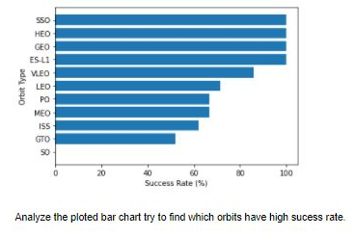
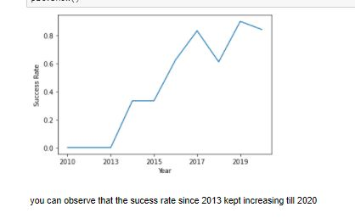
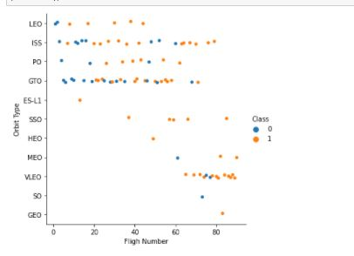
EDA with Data Visualization
We explored the data by visualizing the relationship between flight number and launch Site, payload and launch site, success rate of each orbit type, flight number and orbit type, the launch success yearly trend.
Bar chat shows comparison among discrete categories
This is to show the categories being compared and a measured value
Line chat show trends in data with respect to time
Scatter plot shows relationship between variables. If such a relationship exist then it can be use to build a machine learning model.
GitHub URL: https://github.com/Njung-Valentine/DATA-SCIENCE-PROFESSIONAL-CERTIFICATE/blob/main/EDA%20with%20Visualization%20lab.ipynb

Slide 15
EDA with SQL
Performed SQL queries
The names of unique launch sites in the space mission.
Displaying 5 records where lunch site begin with string ‘CCA’
The total payload mass carried by boosters launched by NASA (CRS)
The average payload mass carried by booster version F9 v1.1
List the date when the first successful landing outcome in ground pad was achieved.
List the names of the boosters which have success in drone ship and have payload mass greater than 4000 but less than 6000
The total number of successful and failure mission outcomes
names of the booster versions which have carried the maximum payload mass. Use a subquery
List the failed landing_outcomes in drone ship, their booster versions, and launch site names for in year 2015
Rank the count of landing outcomes (such as Failure (drone ship) or Success (ground pad)) between the date 2010-06-04 and 2017-03-20, in descending order
Add the GitHub URL: https://github.com/Njung-Valentine/DATA-SCIENCE-PROFESSIONAL-CERTIFICATE/blob/main/DEA%20with%20SQL.ipynb

Slide 16
Build an Interactive Map with Folium
We marked all launch sites, and added map objects such as markers, circles, lines to mark the success or failure of launches for each site on the folium map.
We assigned the feature launch outcomes (failure or success) to class 0 and 1.i.e., 0 for failure, and 1 for success.
Using the color-labeled marker clusters, we identified which launch sites have relatively high success rate.
We calculated the distances between a launch site to its proximities. Like railways, highways and coastlines.
Add the GitHub URL: https://github.com/Njung-Valentine/DATA-SCIENCE-PROFESSIONAL-CERTIFICATE/blob/main/Interactive%20Visual%20Analytics%20with%20Folium%20lab%20(1).ipynb

Slide 17
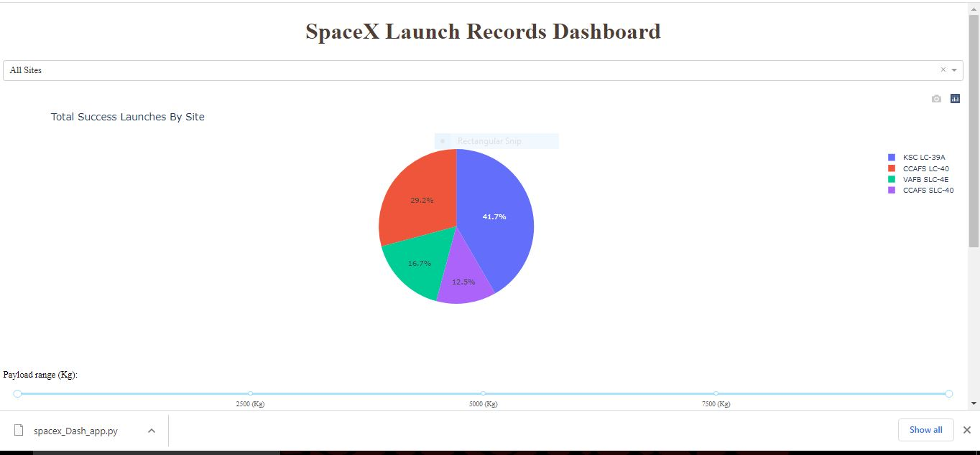
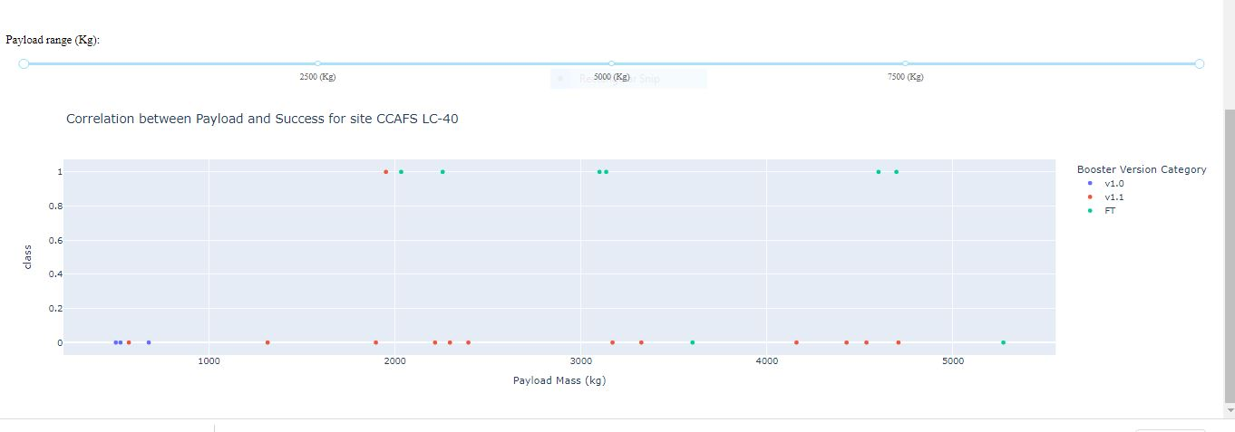
Build a Dashboard with Plotly Dash
We created a dropdown list to enable lunch site selection.
We Added a pie chart to show total successful lunch count for all sites and the success vs failed count of a site if a particular lunch site was selected
We plotted scatter graph showing the relationship with Outcome and Payload Mass (Kg) for the different booster version.
Add the GitHub URL: https://github.com/Njung-Valentine/DATA-SCIENCE-PROFESSIONAL-CERTIFICATE/blob/main/spacex_Dash_app%20(2).py

Slide 18
Create a k nearest neighbors object then create a GridSearchCV object knn_cv with cv = 10. Fit the object to find the best parameters from the dictionary parameters.
Predictive Analysis (Classification)
Created a NumPy array from the column Class in data
Standardize the data with a standard scalar then fitting and transforming it.
Using the function train_test_split, we split the data into training and test data
We create a logistic regression object then create a GridSearchCV object logreg_cv with cv = 10, to find the best parameters
We calculate the accuracy on the test data using the method score
Creating a k nearest neighbors object then create a GridSearchCV object knn_cv with cv = 10. Fit the object to find the best parameters from the dictionary parameters.
We Calculate the accuracy of tree_cv on the test data using the method score
We create a decision tree classifier object then create a GridSearchCV object tree_cv with cv = 10. Fit the object to find the best parameters from the dictionary parameters.
We calculate the accuracy on the test data using the method score:
We create a GridSearchCV object svm_cv with cv - 10. Fit the object to find the best parameters from the dictionary parameters.
We Calculate the accuracy of tree_cv on the test data using the method score
Finding the method performs best by examining the jaccard_score and F1 score matrics
GitHub URL: https://github.com/Njung-Valentine/DATA-SCIENCE-PROFESSIONAL CERTIFICATE/blob/main/Machine%20Learning%20Prediction%20lab.ipynb

Slide 19
Results
Exploratory data analysis results
Interactive analytics demo in screenshots
Predictive analysis results

Slide 20

Section 2

Slide 21

Flight Number vs. Launch Site
Launch Site vs Flight Number
From the plot, we found that the larger the flight amount at a launch site, the greater the success rate at a launch site.
The earliest flights all failed while the later flights all succeeded

Slide 22
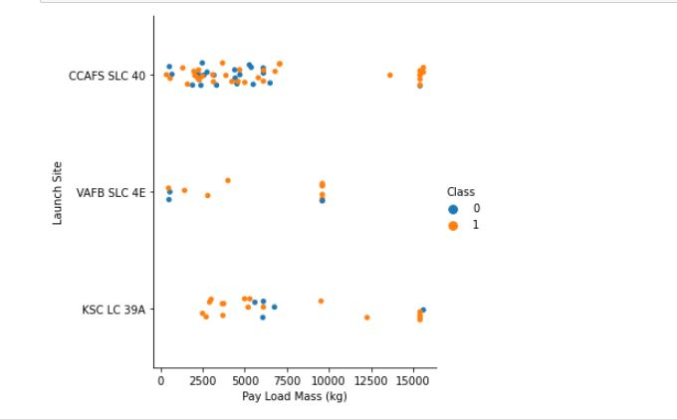
Payload vs. Launch Site
Payload vs. Launch Site
For every lunch site, the higher the payload mass the higher success.
Most of the lunches with payload mass over 7000 were successful

Slide 23
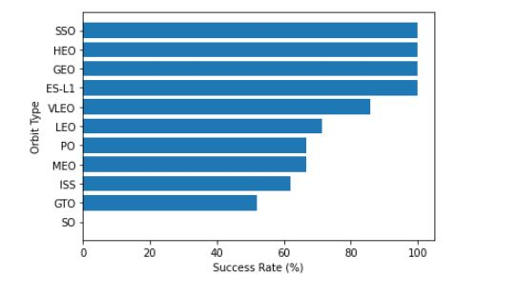
Success Rate vs. Orbit Type
From the plot, we can see that ES-L1, GEO, HEO, SSO, VLEO had the most success rate.
Orbit with 0% success rate SO

Slide 24
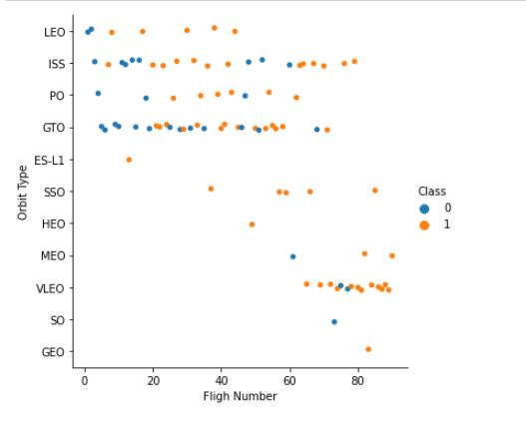
Flight Number vs. Orbit Type
Orbit Type vs Flight Number
We observe that in the LEO orbit, success is related to the number of flights whereas in the GTO orbit, there is no relationship between flight number and the orbit.

Slide 25
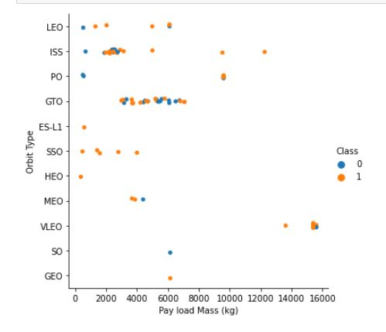
Payload vs. Orbit Type
with heavy payloads have negative influence on GTO orbit and positive on polar LEO orbits. the successful landing are more for PO, LEO and ISS orbits.

Slide 26
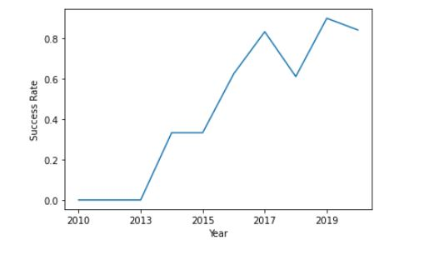
Launch Success Yearly Trend
The success rate since 2013 kept increasing till 20120

Slide 27
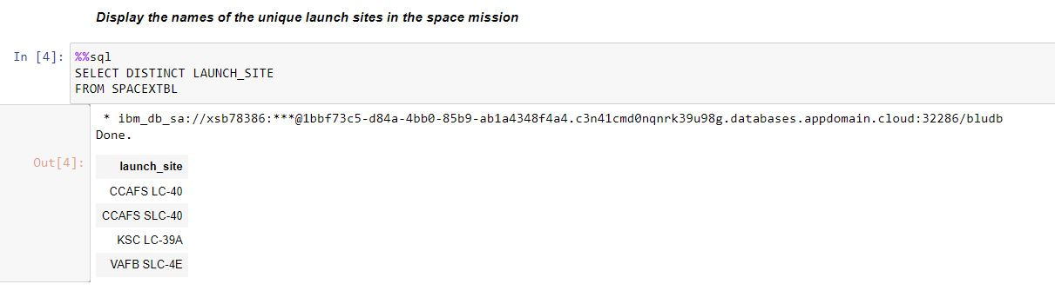
All Launch Site Names

Slide 28
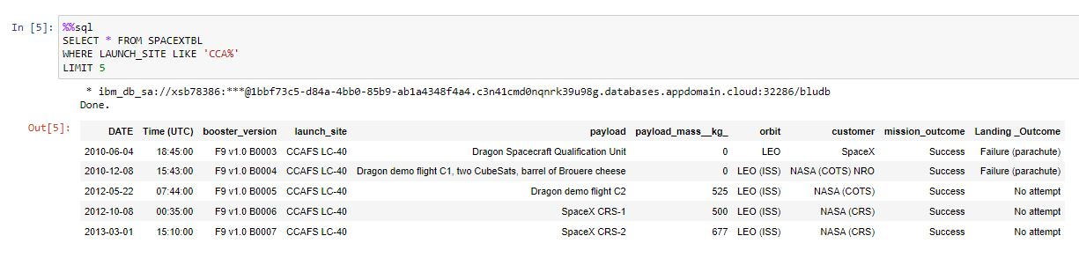
Launch Site Names Begin with 'CCA'
We used the query above to display 5 records where launch sites begin with ‘CCA’

Slide 29
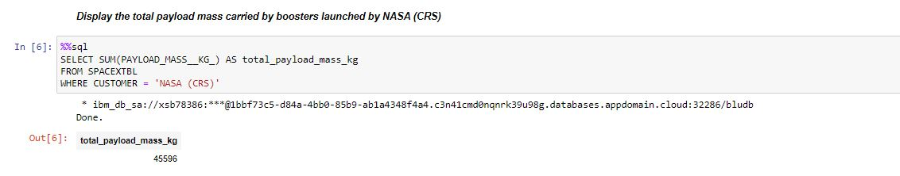
Total Payload Mass

Slide 30
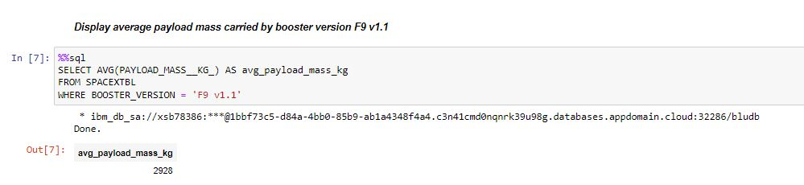
Average Payload Mass by F9 v1.1

Slide 31
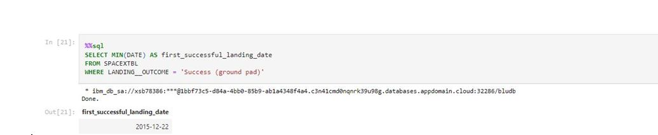
First Successful Ground Landing Date

Slide 32
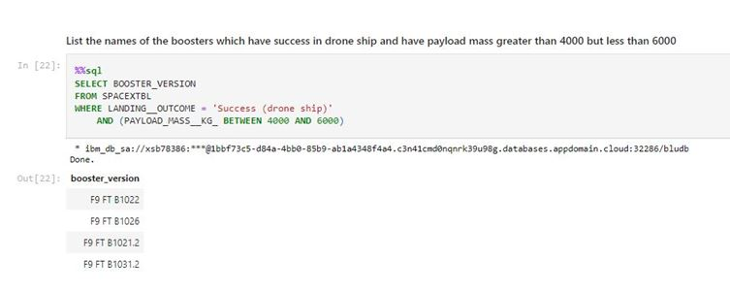
Successful Drone Ship Landing with Payload between 4000 and 6000

Slide 33
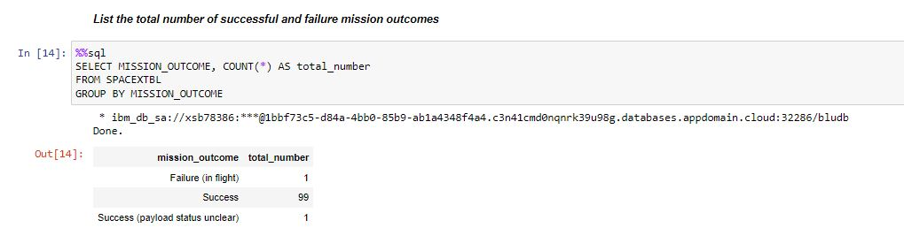
Total Number of Successful and Failure Mission Outcomes

Slide 34
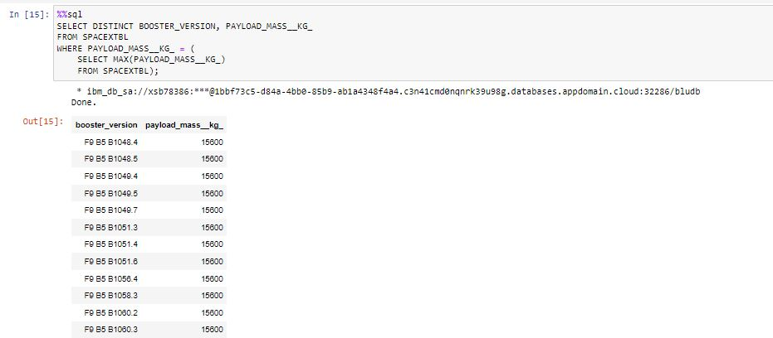
Boosters Carried Maximum Payload

Slide 35
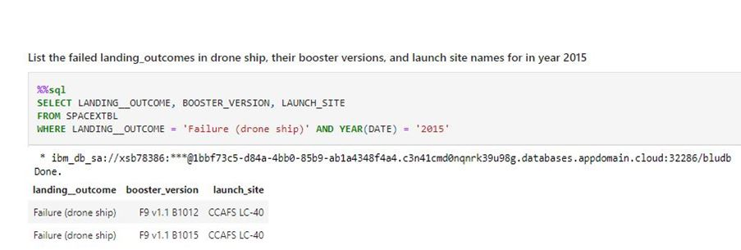
2015 Launch Records

Slide 36
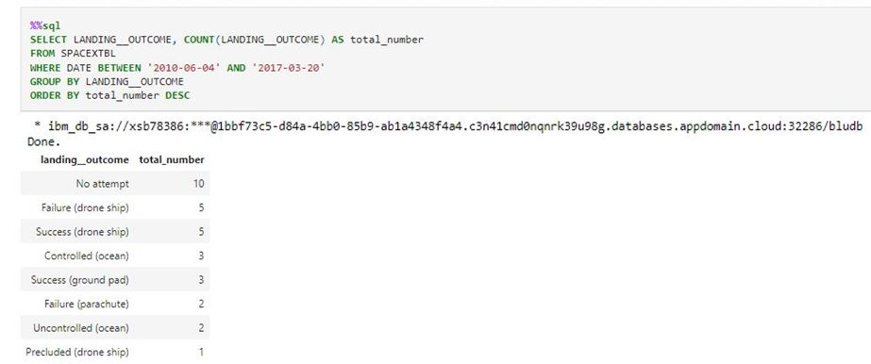
Rank Landing Outcomes Between 2010-06-04 and 2017-03-20

Slide 37

Section 3

Slide 38
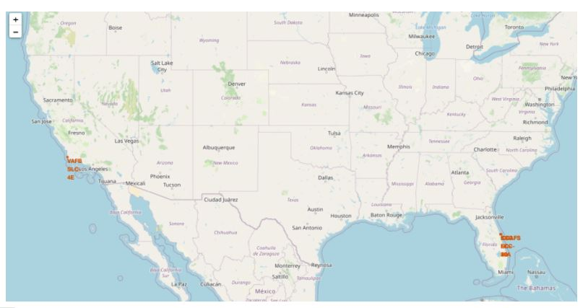
All launch sites global map markers

Slide 39

Markers showing launch sites with color labels

Slide 40

Launch Site distance to landmarks

Slide 41

Section 4

Slide 42
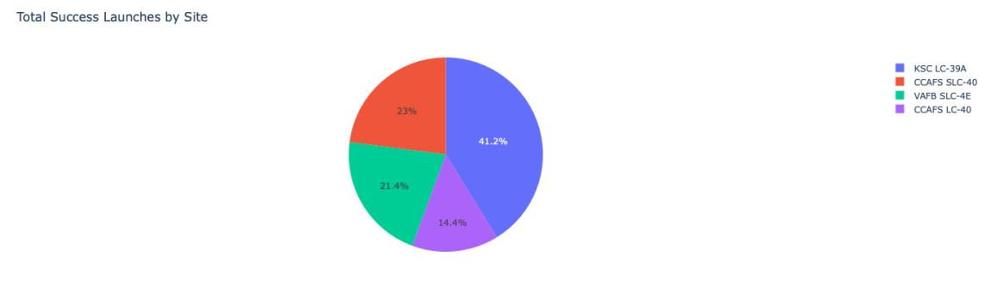
Pie chart showing the success percentage achieved by each launch site

Slide 43

Launch site with the highest launch success ratio

Slide 44
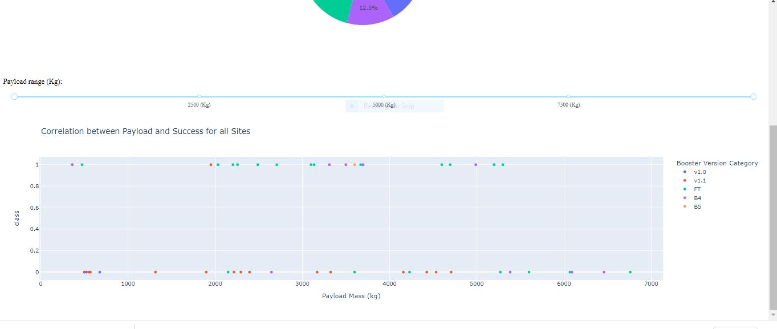
correlation between payload mass and lunch outcome for each site

Slide 45

Section 5

Slide 46
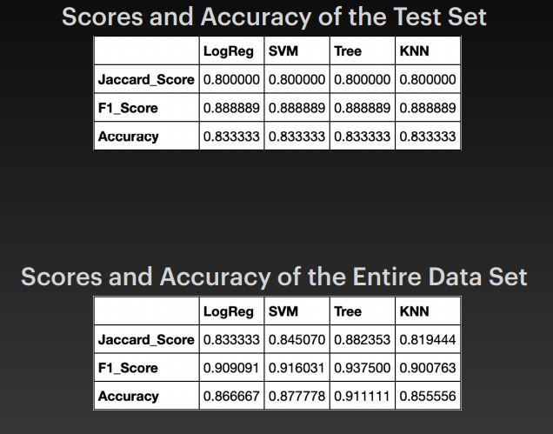
Classification Accuracy
Scores and accuracy of test set
Scores and accuracy of the entire data set
The scores of the entire data set confirms that the best model is the decision tree model. This model has both higher score and accuracy .

Slide 47
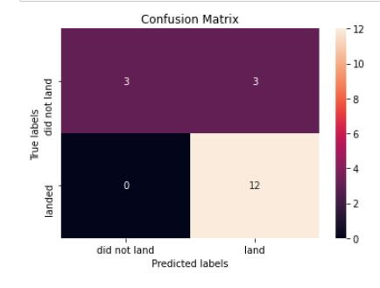
Confusion Matrix
The confusion matrix for the decision tree classifier shows that the classifier can distinguish between the different classes. The major problem is the false positives .i.e., unsuccessful landing marked as successful landing by the classifier.

Slide 48
Conclusions
The decision tree model is the best algorithm for this dataset.
Launches with low payload mass show better results than launches with larger payloads..
Most of launches are in proximity to the equator line and all the sites are in very close proximity to the coast.
Over the years there is an increase the success rate of the launches.
Orbits ES-L1, GEO, HEO, SSO, VLEO had the most success rate.
KSC LC-39A had the most successful launches of any sites

Slide 49


